Slide 1
Yoga
Energising Environments
Yoga | KS1 | Energising Environments | Coastal Caper | Lesson 1

Slide 3
Can you find five animals that live at the coast?
What will we find on our journey to the coast?

Slide 4
Aim
I can root my feet on to the ground.
Success Criteria
I can keep my feet steady on the floor.
I can follow instructions carefully.
I can stay in my own space.

Slide 6
Coastal Caper
Has anyone done yoga before?
What sort of people can do yoga?
What sort of people will be best at yoga?
Yoga is for everybody! Doing yoga is about finding a way that is comfortable for you.
Yoga is not about being the best but about feeling good. Some people will enjoy the poses most, others will be really good at the breathing or meditation.
When we feel good about ourselves, we are happy and able to care for others. We can help make the world a better place for everyone.

Slide 7
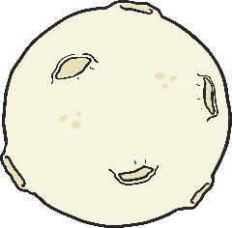
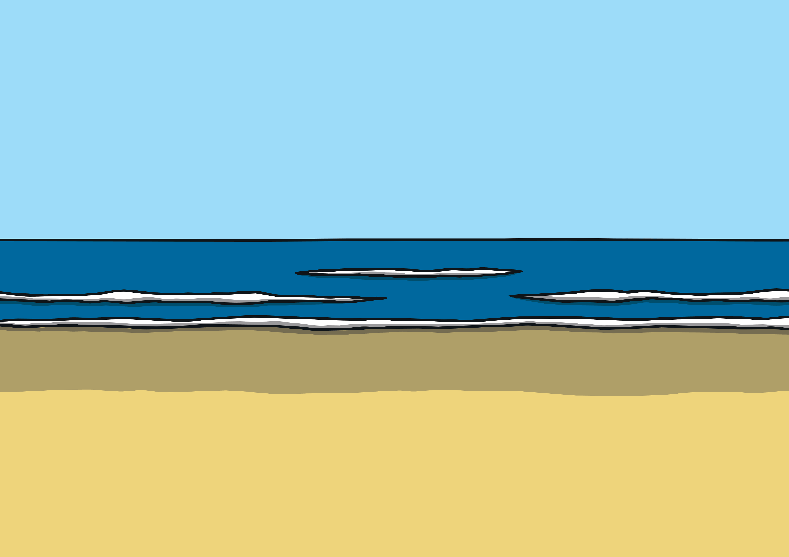
Coastal Caper
The waves we see are created by the moon and the sun.
The force around the moon and sun pulls and pushes the waves backwards and forwards.
This creates tides. When the tide is high, it comes high up the beach.
When the new moon comes, the tides are more active. This is called a ‘spring tide’ as the waves spring forwards up the beach. During spring tides, there will be very little beach left at high tide and lots of beach to see at low tide.
After a week of the ‘spring tides’ they turn to ‘neap tides’, where the tides are weaker and don’t come so far up the beach or so low down the beach.
When it is low, the edge of the water is further away.

Slide 8
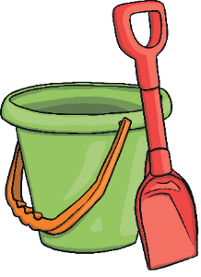
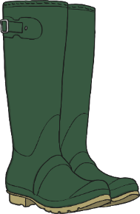
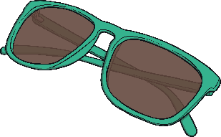
Coastal Caper
We are going to the coast to go rockpooling.
What do we need to take with us?
Let’s act out getting what we need.
We need a net, bucket and spade.
Let’s put on our wellies, sun hat and sun glasses too.
Now it’s time to begin our adventure.

Slide 10
Waves
Let’s pretend that we are the sea.
Make small waves with your hands.
Now your arms.
Now your legs.
Now your toes.
Now your head.
Now your back.
Now use your whole body.
Let’s make the waves tiny like at the edge of the sea.
Let’s make them bigger so we can jump over them.
Now let’s make them huge so your whole body is an enormous crashing wave.
Remember to make sure you don‘t touch anyone.

Slide 11
What Might We See?

Slide 12
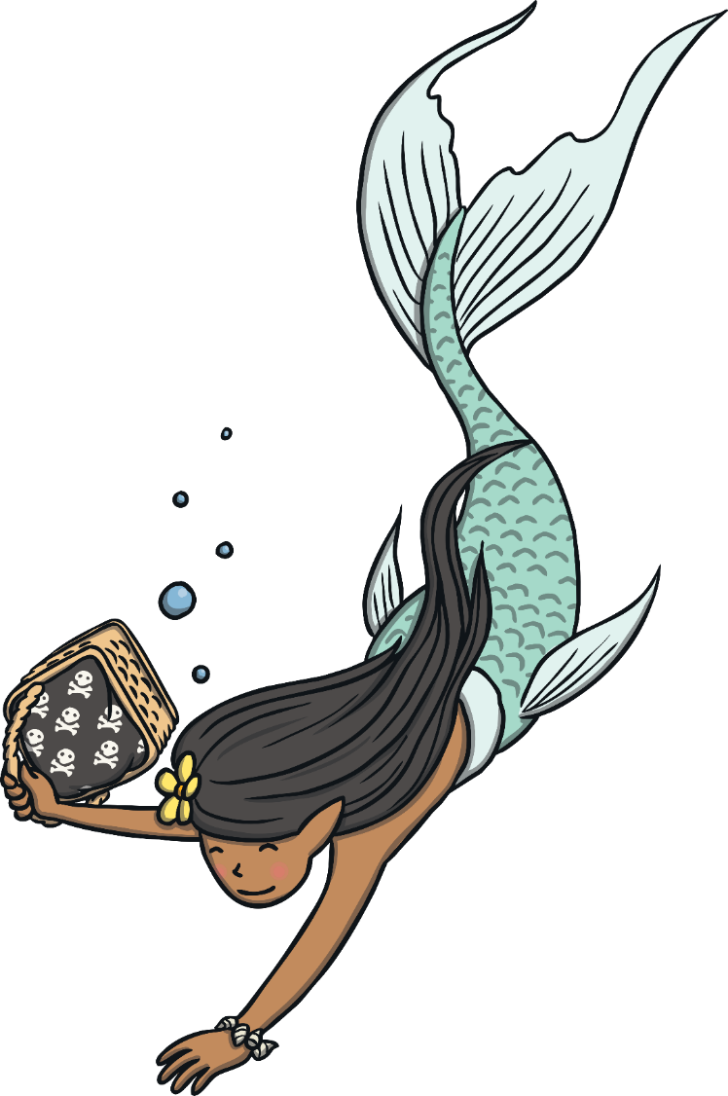
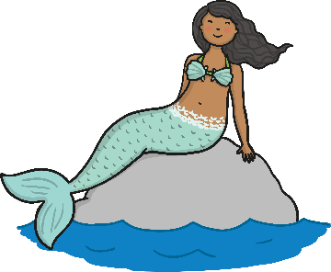
Mermaid
Things we need to know before we do the pose:
This twist is for your spine.
Make the twist smaller if it‘s ever uncomfortable.
Whilst doing this pose, your tummy muscles slightly draw back towards your spine.

Slide 13
Mermaid
Let’s be a Mermaid!
Lie on your back, feet close to your bottom, knees together.
Stretch your hands out wide, with your palms up.
Now, smoothly slide your knees over to one side.
Maybe your head will turn away from your knees.
Now, bring your knees up to the centre again.
Repeat this pose twice or three times on each side.
Click on the image for a closer look!

Slide 14
Mermaid

Slide 15
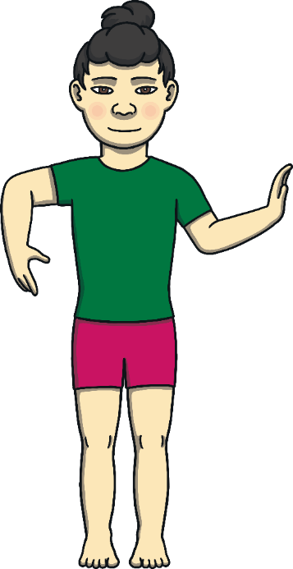
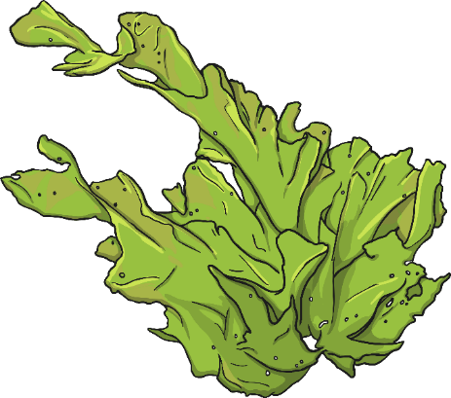
Seaweed
Things we need to know before we do the pose:
This pose will help you relax your shoulders.

Slide 16
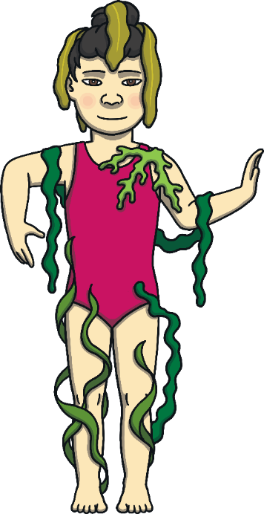
Seaweed
Let’s move like seaweed.
Start by standing up tall.
Can you move your hands like seaweed in a rock pool?
Make your movements like lovely, slippery, slidy seaweed.
Move your hands so they move like seaweed too.
Now can you make your shoulders like seaweed?
Can you make big circles with your shoulders?
Can you let the movement spiral and float down your arms?
Repeat this pose once or twice.

Slide 17
Seaweed

Slide 18
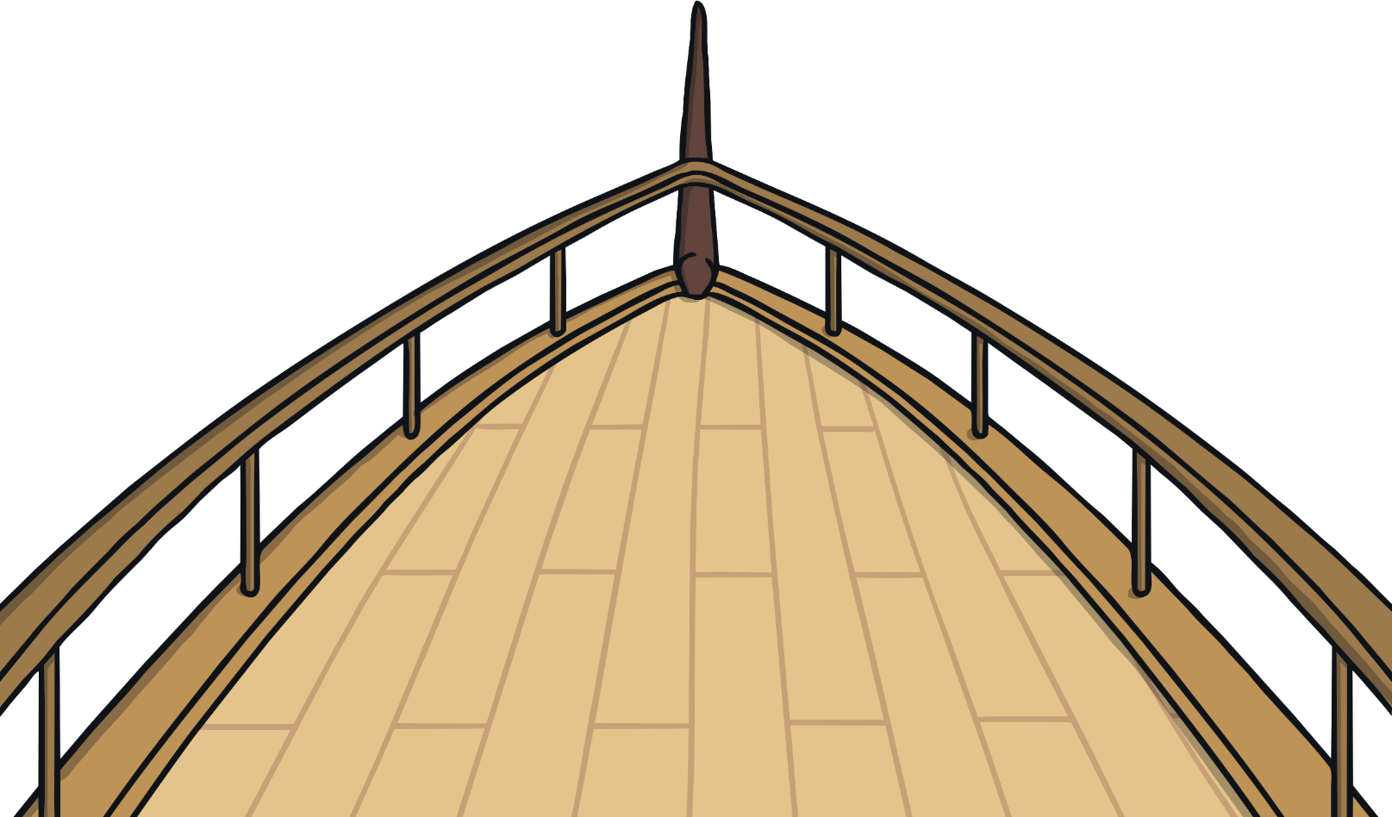
Boat

Slide 19
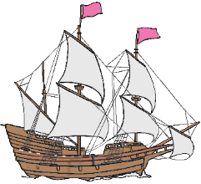
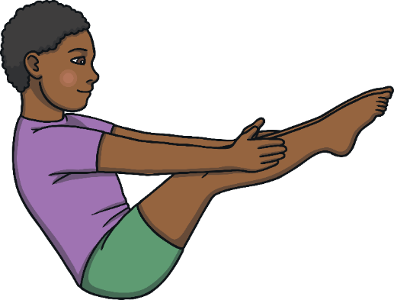
Boat
Things we need to know before we do the pose:
This pose will help you to work your tummy and hips.
This needs strong tummy muscles.
Whilst doing this pose, your tummy muscles slightly draw back towards your spine.
Balance and bring your feet down if your boat rocks too much.

Slide 20
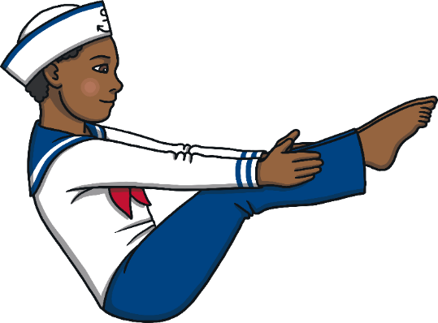
Boat
Let’s be a boat!
Sit with your knees bent upwards.
Draw your feet in close.
Take hold behind your knees and then lift your feet away from the floor.
Your arms can keep hold on or stretch out towards your toes.
Now draw your knees towards you…can you stretch them out again?
Maybe your boat can rock a little?
Now come back to feet on the floor, nice and steady.
Repeat this pose twice or three times.

Slide 21
Boat

Slide 22
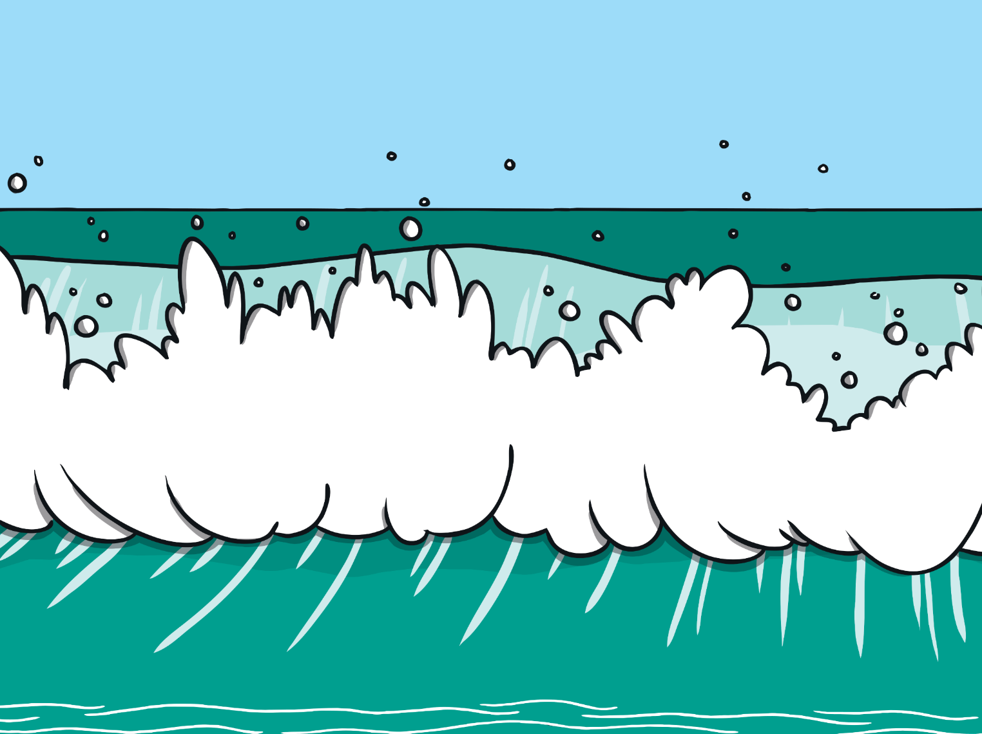
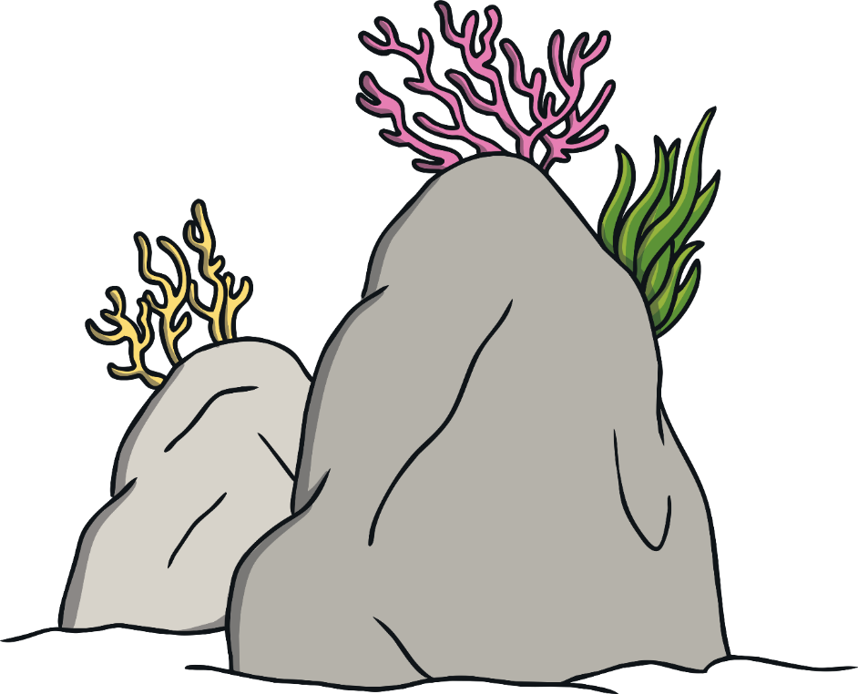
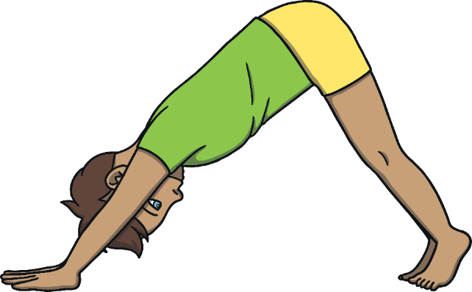
Limpet
Things we need to know before we do the pose:
This pose will let your heart be lower than your hips.
This pose needs strong feet and hands.
Strong feet and hands stay on the floor at all times.
If at any point you don‘t like how it feels, just bring your knees back on to the floor and rest.

Slide 23
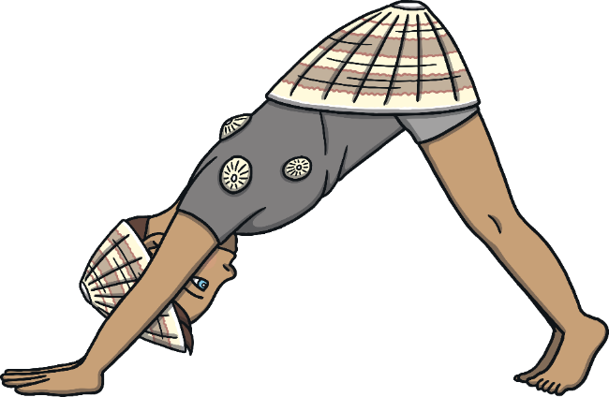
Limpet
Let’s be a limpet!
Start in all fours.
Press your hips back and then press into your hands and feet to lift your hips.
Stretch your hips up to the sky to make a nice pointy limpet shell.
Keep your head relaxed and keep breathing happily.
Now come back to all fours, knees down on the floor.
Repeat this pose twice or three times.

Slide 24
Limpet

Slide 25
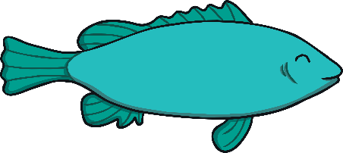
Fish
Things we need to know before we do the pose:
This pose gives you a lovely back bend.
If it feels uncomfortable at any point, make your waves smaller.

Slide 26
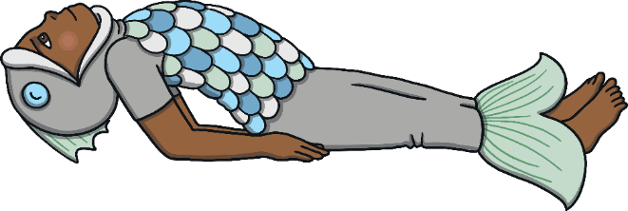
Fish
Let’s be a fish!
Lie comfortably on your back.
Stretch your feet away.
Press down with your elbows to lift your back and shoulders off the floor.
Keep your head rested down but look back if it feels good.
Keep steady, even breathing and enjoy being a fish!
Now come back to lying flat on the floor.
Repeat this pose twice or three times.

Slide 27
Fish

Slide 28
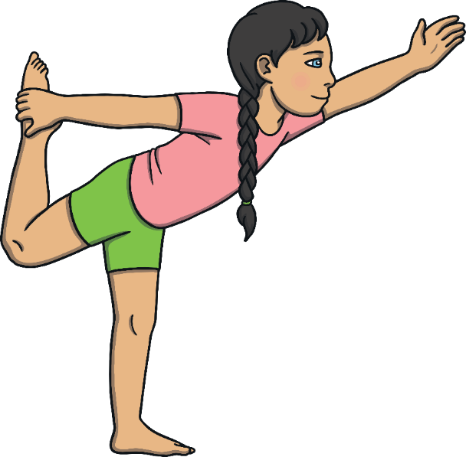
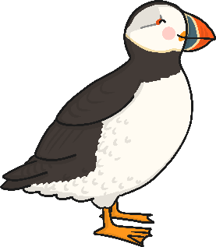
Puffin
Things we need to know before we do the pose:
This pose will help you to balance.
Puffins make sure they have space for their wings.
If you are wobbly, bring both feet on to the ground.
Start with both feet on the ground and feel steady.

Slide 29
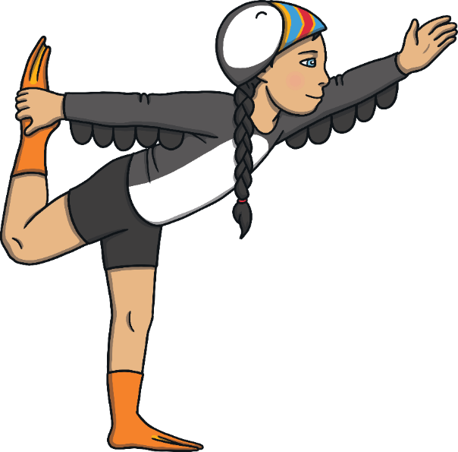
Puffin
Let’s be a puffin!
Take one foot up behind you so it’s close by your hips or bottom.
Take your hand, on the same side, behind you and hold on to your ankle or let your leg float.
Keep steady.
Stretch your free hand high out in front.
Keep breathing easily.
Now bring both feet down on the ground again.
Repeat this pose twice or three times on each side.

Slide 30
Puffin

Slide 31
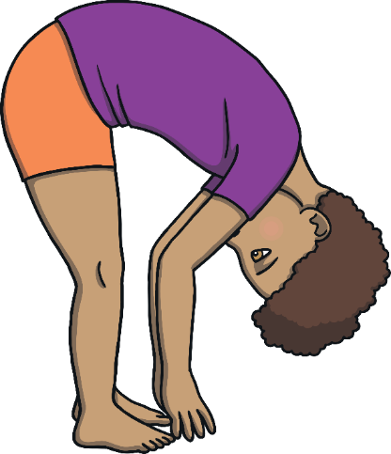
Waves
Things we need to know before we do the pose:
This pose helps your back to bend forwards.
Start with both feet on the ground and feel steady.
If it feels uncomfortable at any point, make your waves smaller.

Slide 32
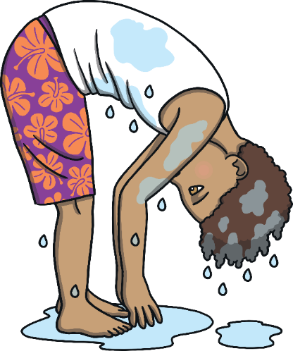
Waves
Let’s make waves!
Stand up tall and strong.
Let your hands come over your head.
Soften your knees a little.
Now sweep your hands down towards the floor like a big soft wave.
Lift up a little and then back down. Move your hands like waves.
Now come back to standing with your hands by your side.
Repeat this pose twice or three times.

Slide 33
Waves

Slide 35
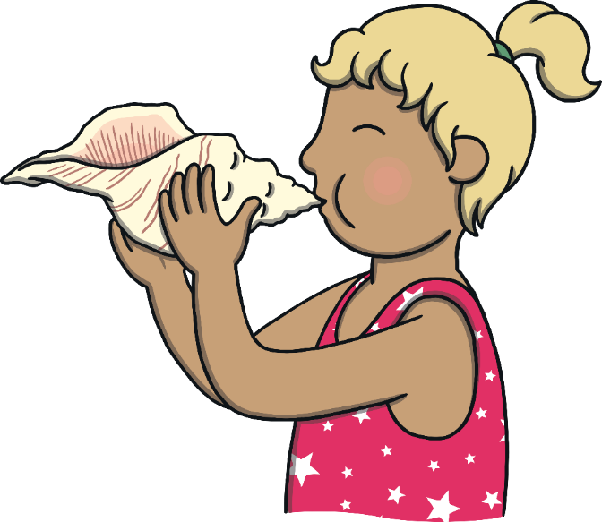
Conch Shell Breathing
We practise breathing to make our breath longer and help us balance.
Today, we’re going to breathe out and make an imaginary sound.
Take your imaginary conch shell horn up to your lips. Your breath out is going to spiral inside the shell and then make a magical noise that only you can hear. See if you can play your imaginary horn very softly. Remember no one else should be able to hear your horn otherwise it might spoil the magic.
Now try strongly. Notice how your breath gets longer when you practise this breathing.

Slide 37
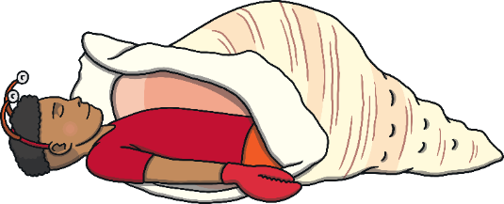
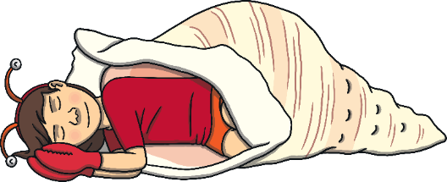
Shell Stars
Lie on your side or your back.
Lie in a space of your own, touching no one.
Look at the ceiling or close your eyes.
You have had a long and exciting journey. Now it’s time to rest.
You’re ready for a peaceful story.

Slide 38
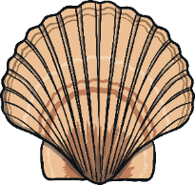
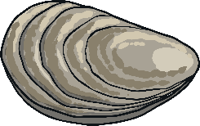
Shell Stars
You are walking along a beach. The sky is blue and the sun is gently shining. You feel happy and relaxed. You walk to the edge of the water and the waves gently touch your toes. You watch the waves going in and out, as they come up the beach to you and then further away. The little white tops froth and play. The waves come in, and out… in, and out. You walk over to the perfect place to lie. There is a soft sandy dip for you to lie in. You lie down. As you relax, it moulds around your body so you feel safe and secure. The sand is as soft as silk. You feel very happy. You notice your breathing, very relaxed, going in and out. You notice the waves going in and out at the same timing as your breathing. You look at the sand and you see tiny glittering white shells, sparkling in the sand. There are hundreds of them, tiny little gleaming shells. They shine like tiny stars.

Slide 39
Shell Stars
Above you, the sky turns to the loveliest shade of midnight blue and tiny stars come out. There are stars above you and shell stars all around you. You enjoy the way they twinkle and glow. You watch a shooting star travel across the night sky and you make a wish. It travels all the way from one side of the sky to the other. You know your wish will come true somewhere in the world and you feel happy in your heart. All is well. You decide it’s time to start coming back home. The night sky gets lighter until it is blue again. You smooth the sand where you were lying and walk along the beach. Past the waves and back to this room. You notice how your head feels, lying on the floor. You gently open your eyes and hear the sounds inside the room.
As quiet as a starfish, come up to sitting. Legs crossed, lips closed, hands on your knee.

Slide 40
Shell Stars
Above you, the sky turns to the loveliest shade of midnight blue and tiny stars come out. There are stars above you and shell stars all around you. You enjoy the way they twinkle and glow. You watch a shooting star travel across the night sky and you make a wish. It travels all the way from one side of the sky to the other. You know your wish will come true somewhere in the world and you feel happy in your heart. All is well. You decide it’s time to start coming back home. The night sky gets lighter until it is blue again. You smooth the sand where you were lying and walk along the beach. Past the waves and back to this room. You notice how your head feels, lying on the floor. You gently open your eyes and hear the sounds inside the room.
As quiet as a starfish, come up to sitting. Legs crossed, lips closed, hands on your knee.

Slide 41
Shell Stars
Above you, the sky turns to the loveliest shade of midnight blue and tiny stars come out. There are stars above you and shell stars all around you. You enjoy the way they twinkle and glow. You watch a shooting star travel across the night sky and you make a wish. It travels all the way from one side of the sky to the other. You know your wish will come true somewhere in the world and you feel happy in your heart. All is well. You decide it’s time to start coming back home. The night sky gets lighter until it is blue again. You smooth the sand where you were lying and walk along the beach. Past the waves and back to this room. You notice how your head feels, lying on the floor. You gently open your eyes and hear the sounds inside the room.
As quiet as a starfish, come up to sitting. Legs crossed, lips closed, hands on your knee.

Slide 42
Shell Stars
Above you, the sky turns to the loveliest shade of midnight blue and tiny stars come out. There are stars above you and shell stars all around you. You enjoy the way they twinkle and glow. You watch a shooting star travel across the night sky and you make a wish. It travels all the way from one side of the sky to the other. You know your wish will come true somewhere in the world and you feel happy in your heart. All is well. You decide it’s time to start coming back home. The night sky gets lighter until it is blue again. You smooth the sand where you were lying and walk along the beach. Past the waves and back to this room. You notice how your head feels, lying on the floor. You gently open your eyes and hear the sounds inside the room.
As quiet as a starfish, come up to sitting. Legs crossed, lips closed, hands on your knee.

Slide 44
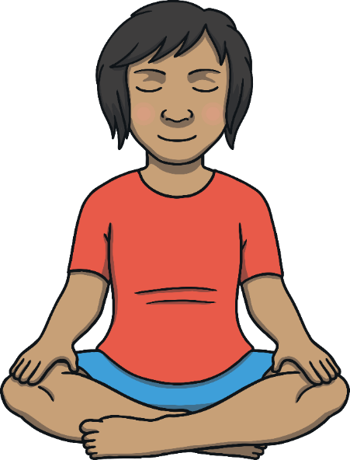
Starfish Meditation
Meditation is the trickiest part of yoga.
Shortly, we are going to learn how to sit quietly for a whole minute.
This will help you make your mind strong.

Slide 45
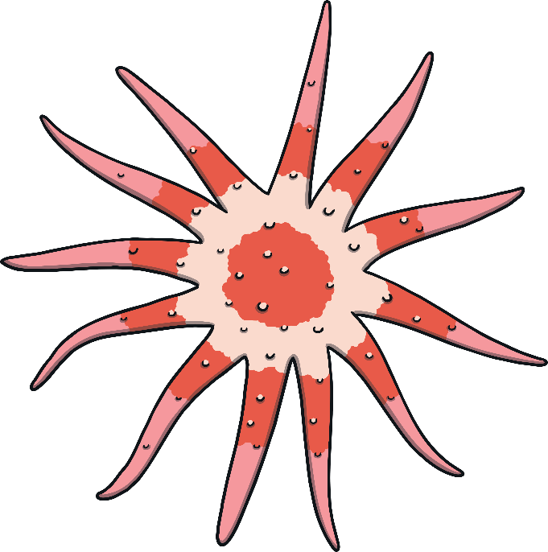
Starfish Meditation
Look at the centre of the starfish and stay focused.
Things to know before we do meditation:
Keep breathing evenly.
Keep your gaze on the starfish or close your eyes.
Stay focused and relaxed.
Start Timer

Slide 47
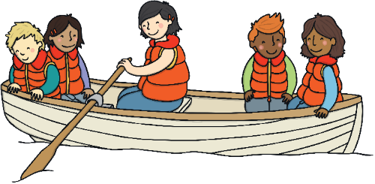
Sailing Home
We have been on a yoga journey. We have learnt how to practise relaxed breathing and how to exercise our minds and bodies to help us feel calmer and happier.
It is time to sail home from our coastal caper.
How did you feel during the lesson?
What have you learnt?

Slide 48
Aim
I can root my feet on to the ground.
Success Criteria
I can keep my feet steady on the floor.
I can follow instructions carefully.
I can stay in my own space.

