Slide 1
Yoga
Energising Environments
Yoga | KS1 | Energising Environments | Jungle Expedition | Lesson 2

Slide 3
What will we find on our jungle expedition?
Can you find five animals that live in the jungle?

Slide 4
Aim
I can lengthen my spine and stand tall.
Success Criteria
I can keep my feet steady on the ground.
I can lift my head and soften my shoulders.
I can keep my body safe.

Slide 6
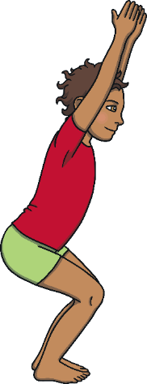
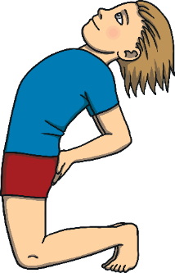
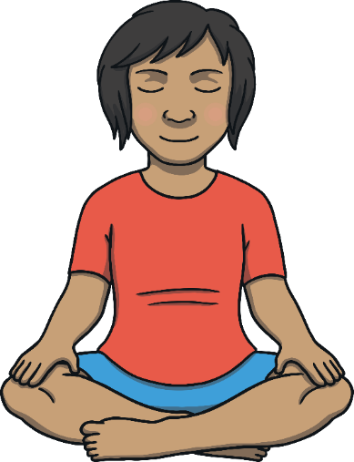
Jungle Expedition
Do you think yoga is competitive?
Do you think you can win or be the best at it?
How do you know if you are doing yoga well?
When we do yoga well, it feels good.
We have to do yoga in a way that feels right for us.

Slide 7
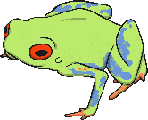
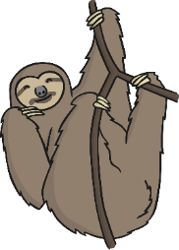
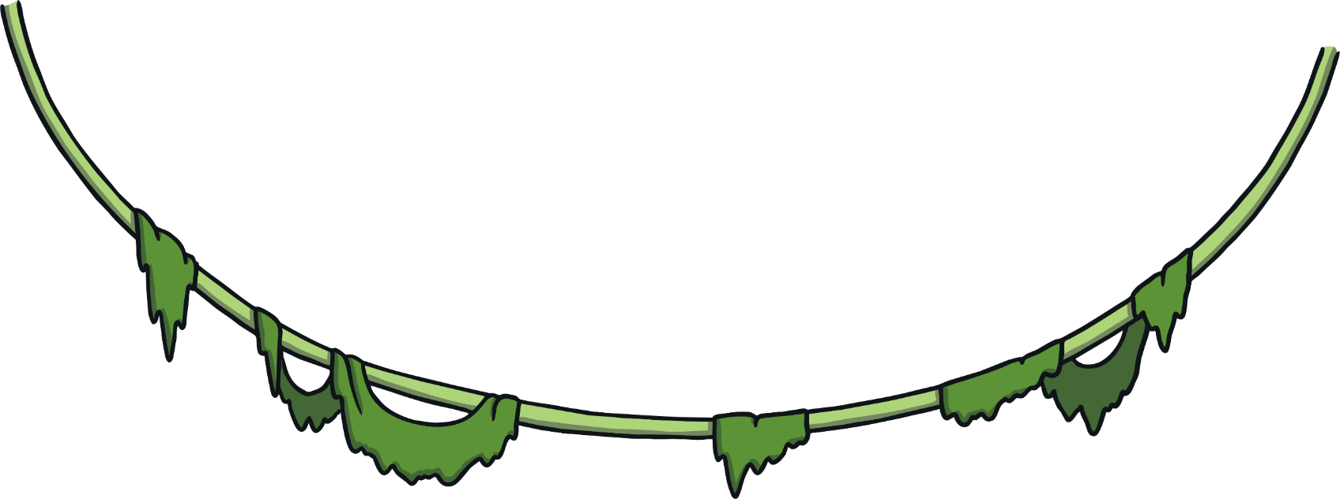
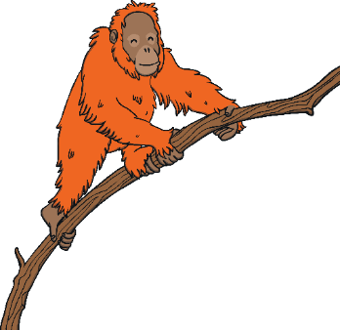
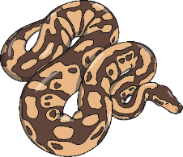
Jungle Expedition
The weather in jungles is very hot and humid. Humid means damp. This helps the tropical plants to grow.
Over half of the world’s animal species live in a jungle. However, jungles cover only a small part of the world. That’s a lot of animals in a small area!
There are lots of different sorts of climbing plants and creepers. Some can grow to around 1000 metres tall. That is ten times the height of Big Ben.

Slide 8
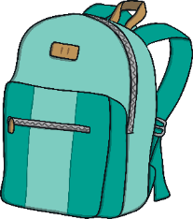
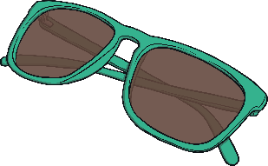
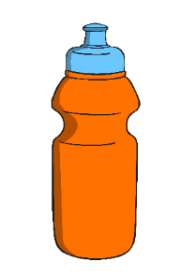
Jungle Expedition
We are going on a jungle expedition.
What do we need to take with us?
Let’s act out getting what we need.
Put on a light shirt, get some water and a backpack full of supplies.
Now, put on a sun hat and sunglasses.
Now it’s time to begin our adventure!

Slide 10
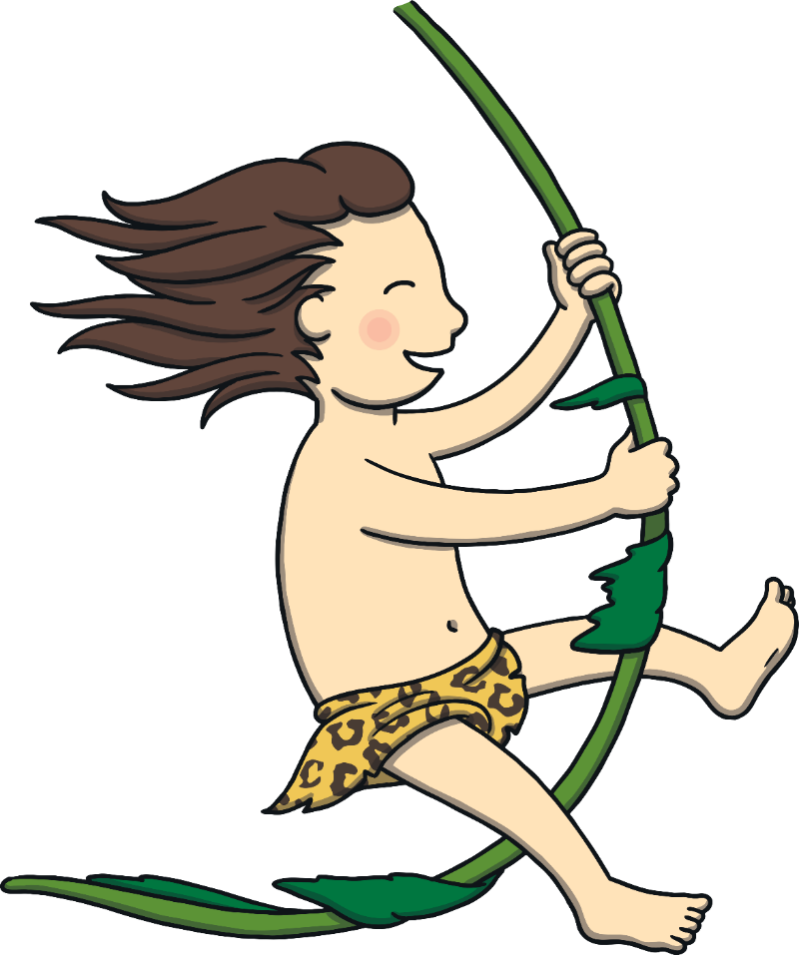
Tarzan
Imagine you are swinging through the jungle, catching one creeper after another. Remember to use both hands.
Now the creepers are further apart, you’re going to have to stretch and leap!
Take care not to touch anyone while you leap around the room like Tarzan.
Pretend you are swinging through the trees using creepers. One hand grabs one, then the other.
Bend your knees to bounce on to a tree branch, grab a creeper and swing over to a higher tree. Now, swing to a lower one.
Swing yourself back to sensible standing.
Let’s pretend we’re in the middle of the jungle.
Can you wind your way through the jungle plants.
Brush them away with your hands…your arms...your legs...even your head!

Slide 11
Jungle Animals

Slide 12
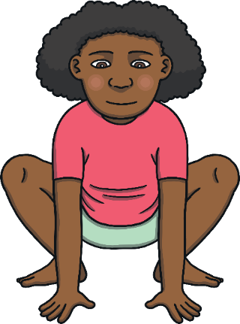
Red-Eyed Frog
Things we need to know before we do the pose:
This pose will stretch your hips.
Lift your hips higher if it feels uncomfortable at any point.
While doing this pose, your back lengthens and hips sink down.

Slide 13
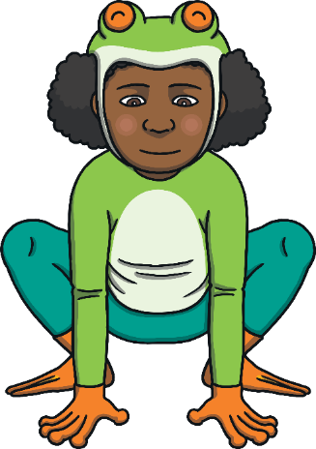
Red-Eyed Frog
Let’s be a red-eyed frog!
Stand up tall with your feet a little apart and toes pointing out.
Slide your hands down your legs and bend your knees.
Sink your hips towards the floor.
Place your palms on your thighs or on to the floor.
Now press into your feet to come back to standing.
Repeat this pose twice or three times.
Click on the image for a closer look!

Slide 14
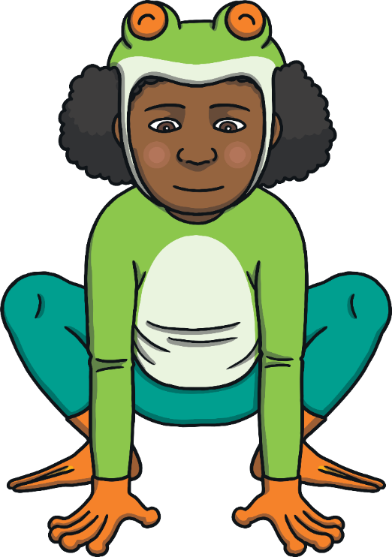
Red-Eyed Frog

Slide 15
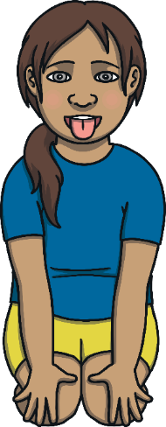
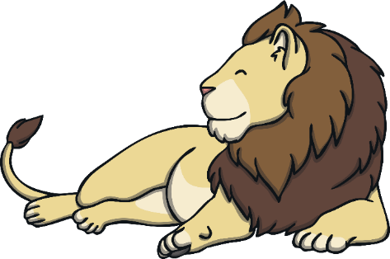
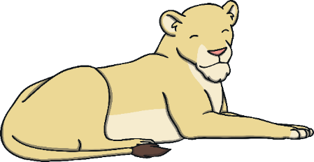
Lion
Things we need to know before we do the pose:
This pose will use your shoulders and breathing.
Raise your hips away from your feet if you are uncomfortable at any point.
Your shoulders draw down towards the floor.

Slide 16
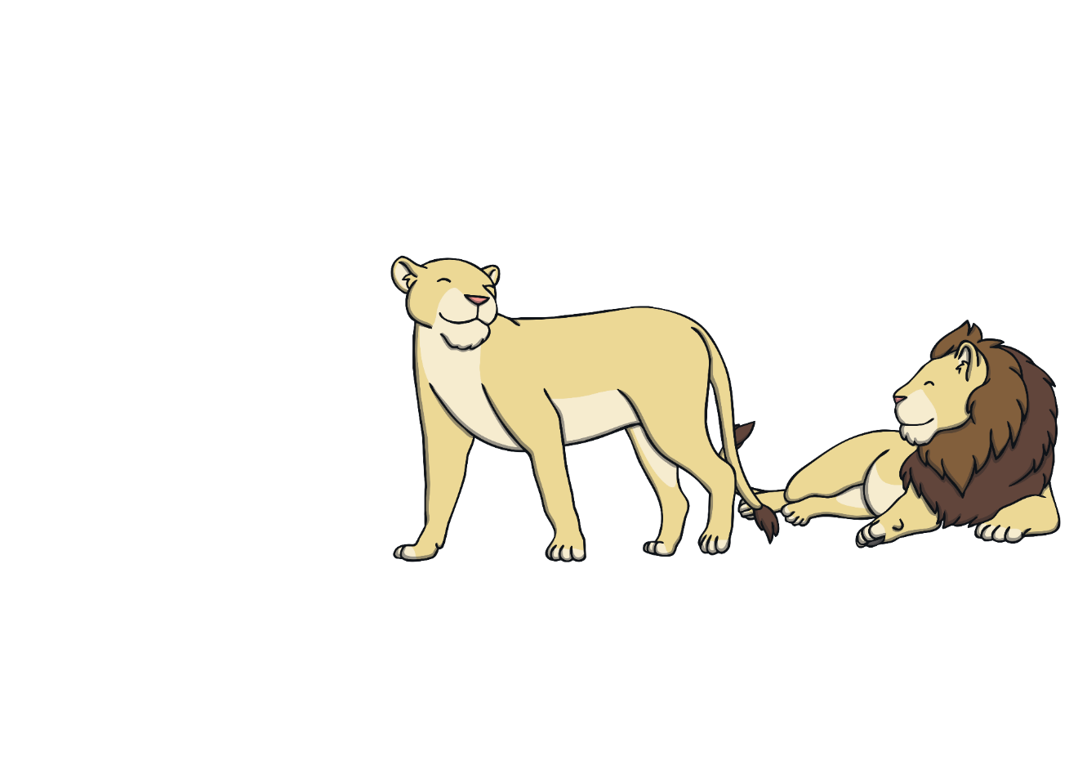
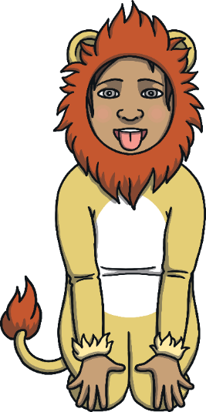
Lion
Let’s be a lion!
Come into kneeling, lifting your hips as high as you need to.
Slide your palms down your thighs.
As you breathe out, press your shoulders down.
Make your hands into claws.
Make a silent roar.
Now come back up and be a friendly lion.
Repeat this pose twice or three times.

Slide 17
Lion

Slide 18
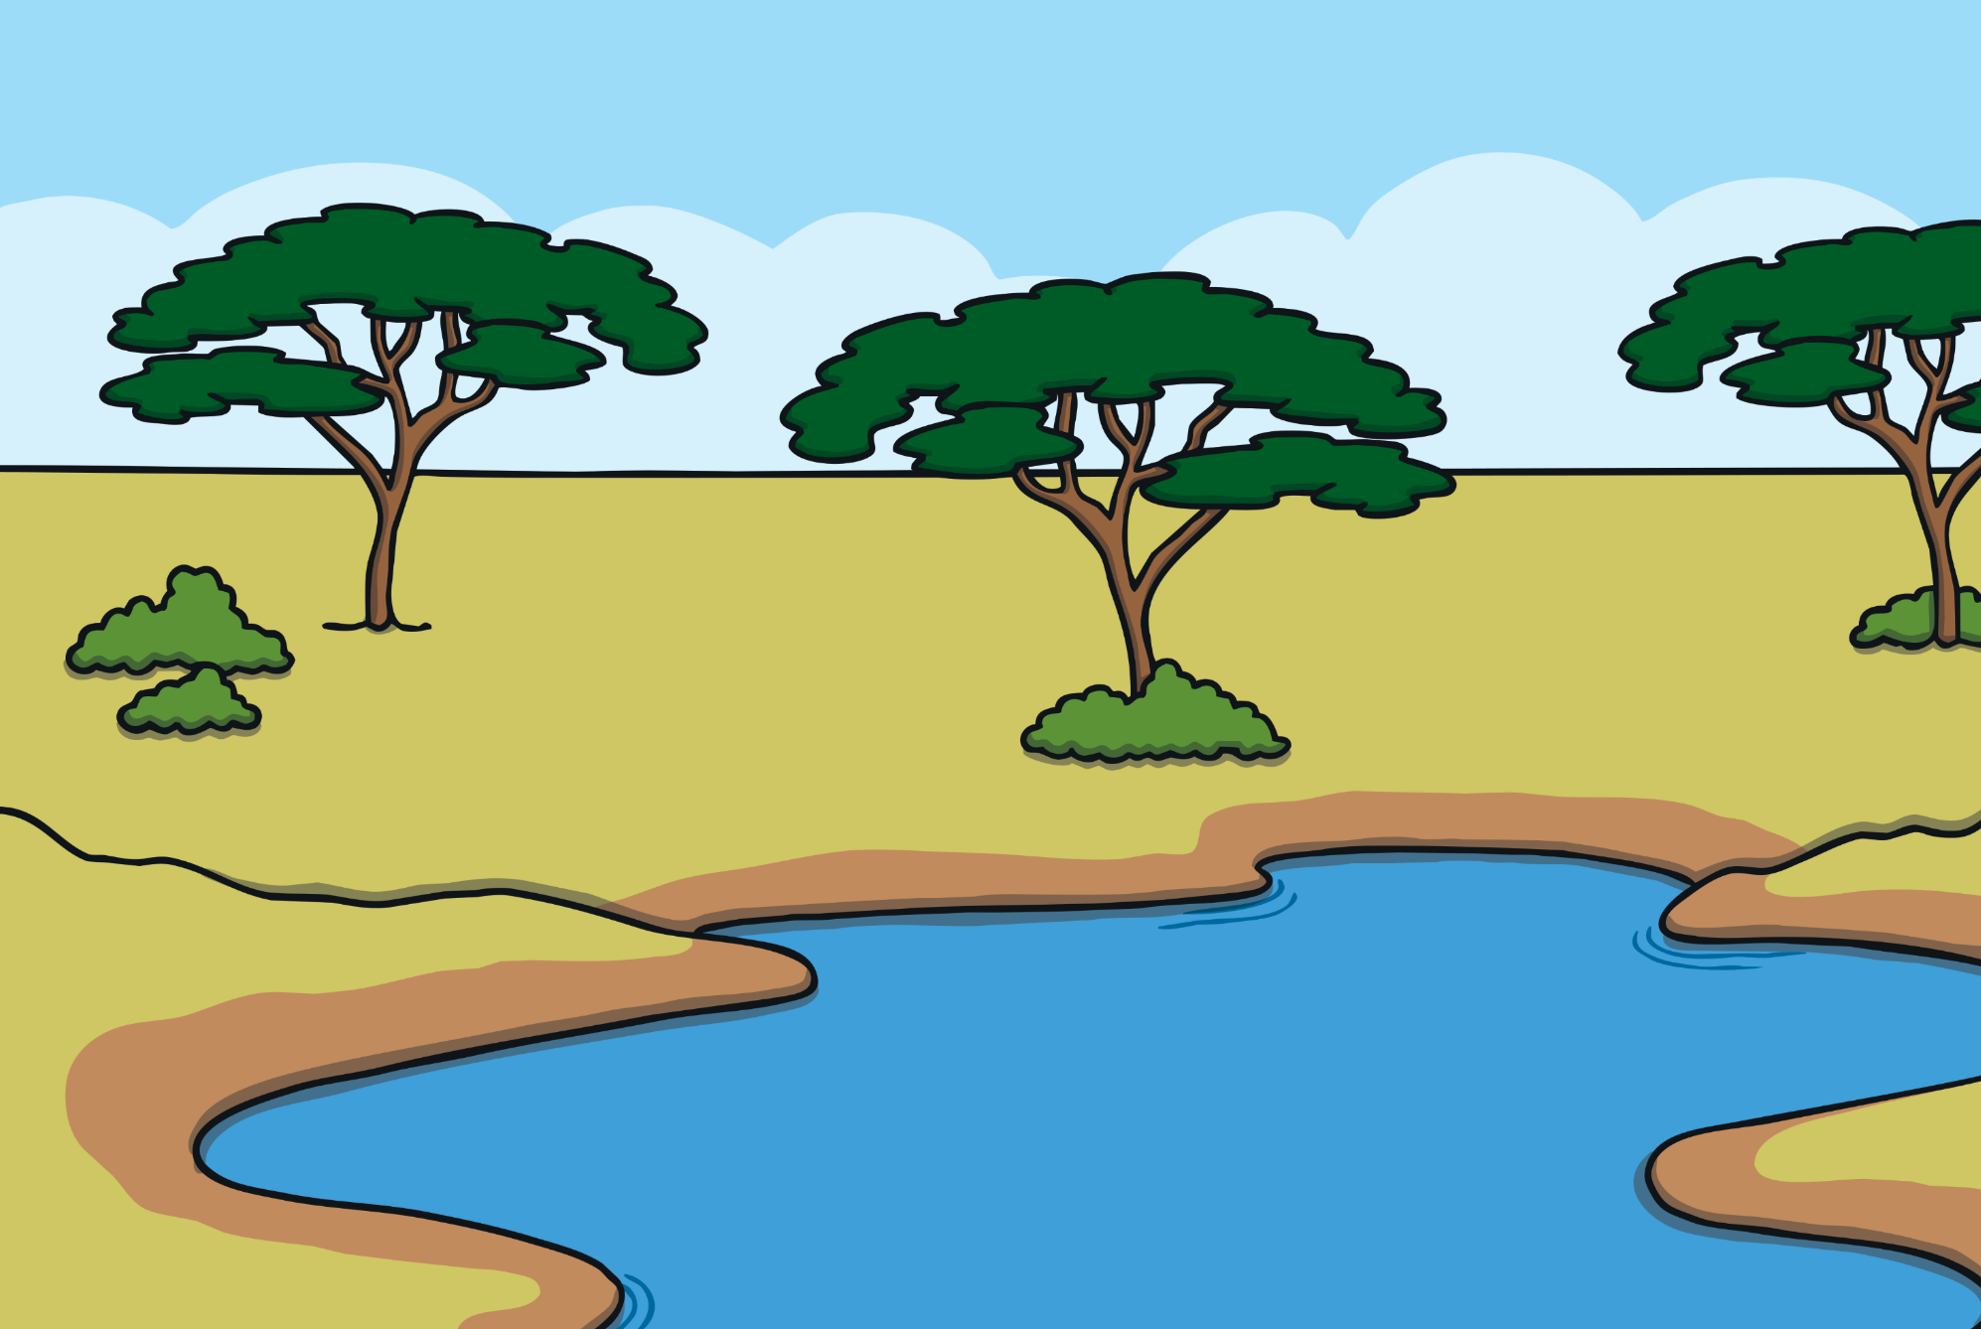
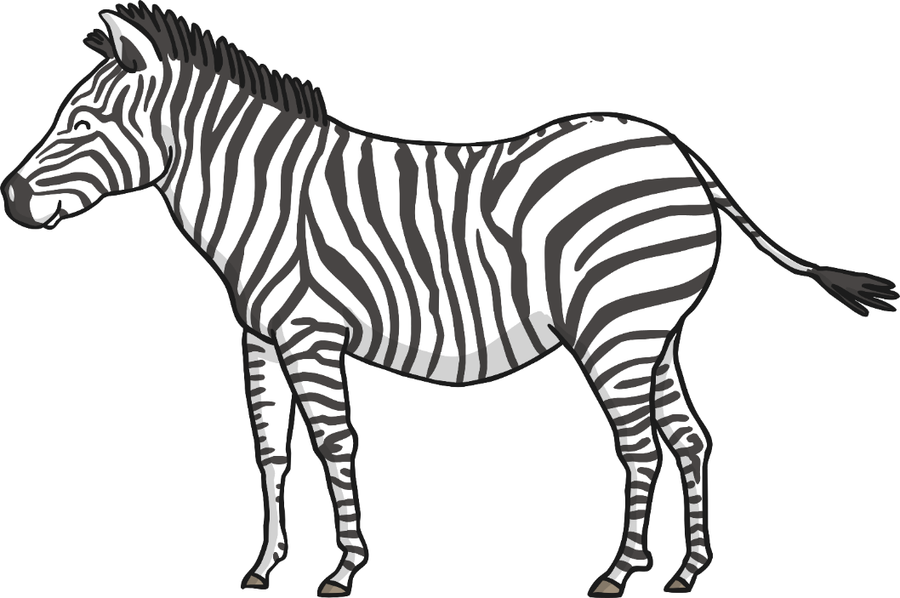
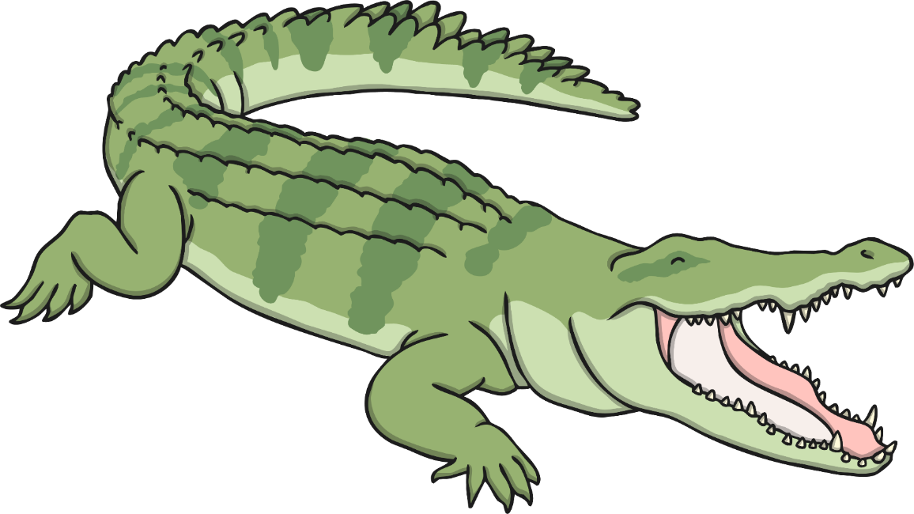
Crocodile
Things we need to know before we do the pose:
This pose lifts your hips higher than your heart.
Your shoulders stay down, your feet and legs stay strong.
Lower your hips if you need to.
Remember to keep breathing.

Slide 19
Crocodile
Let’s be a crocodile!
Lie on your back.
Bring your feet close to your hips.
Press into your feet to lift your hips.
Stretch your hands overhead and on the floor. Imagine your arms as crocodile jaws.
Keep your shoulders relaxed and breathe.
Now, slowly and gently bring your hips down.
Repeat this pose twice or three times.

Slide 20
Caiman

Slide 21
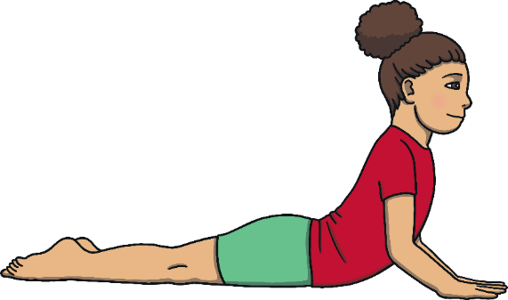
Boa Constrictor
Things we need to know before we do the pose:
This pose stretches your back and lengthens your tummy.
This pose needs a strong tummy and back.
Keep closer to the floor if you’re not sure or if you are uncomfortable at any point.
Move smoothly and gently.

Slide 22
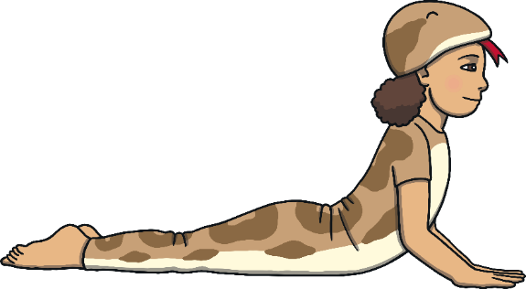
Boa Constrictor
Let’s be a boa constrictor!
Start on your tummy.
Hands are under your shoulders.
Elbows are close to your body.
Press into your hands to come up a little, taste the air like a snake.
Rest down.
This time come up a little higher as you breathe in.
Light up your beady snake eyes, then come down to rest.
Repeat this pose twice or three times.

Slide 23
Boa Constrictor

Slide 24
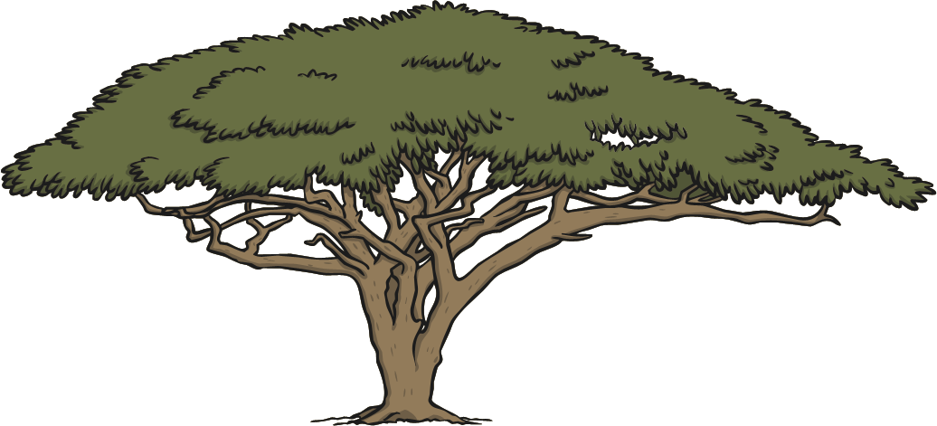
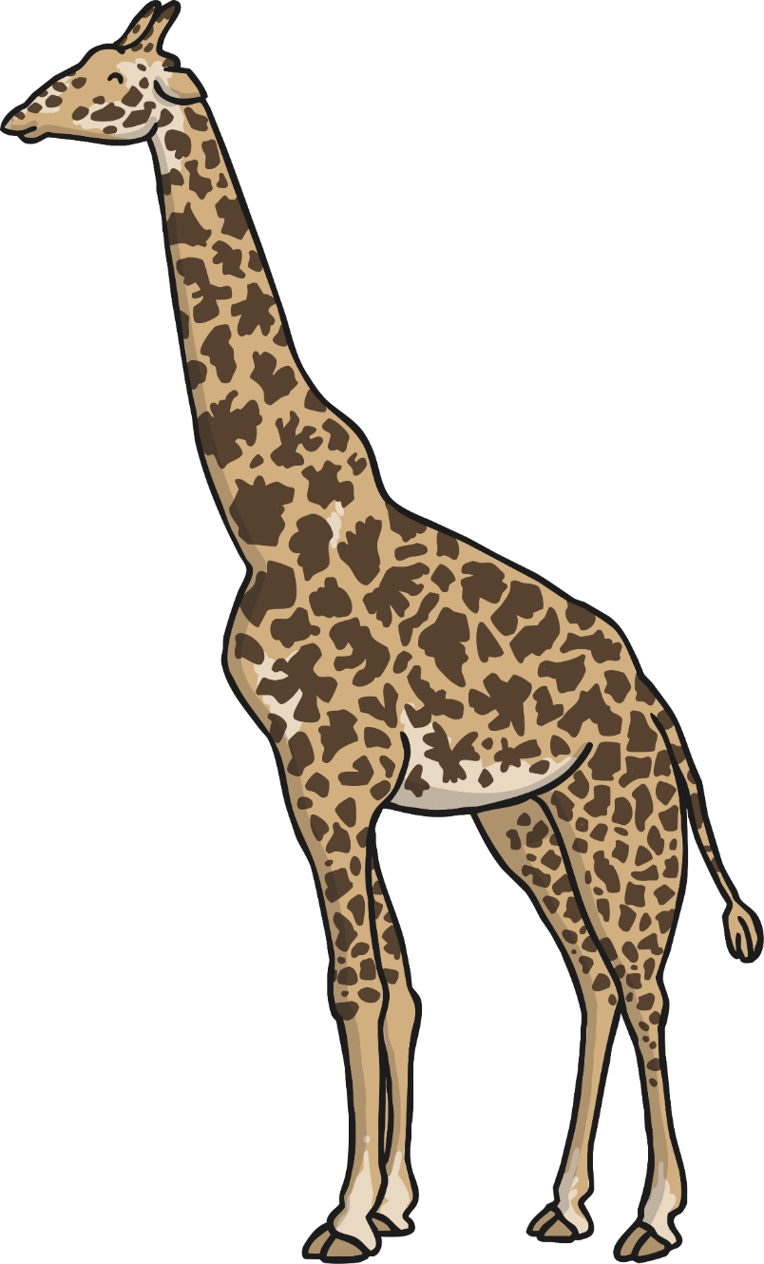
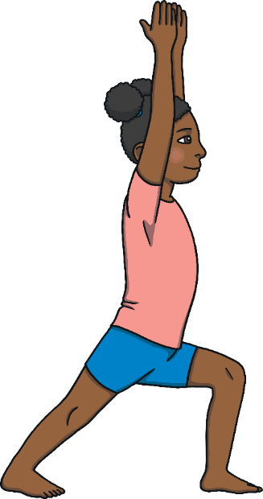
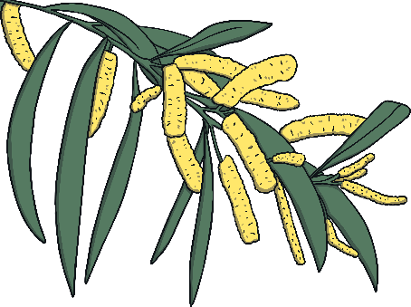
Giraffe
Things we need to know before we do the pose:
This pose will help you balance.
Your feet need to be steady on the ground.
If you wobble, come back to standing and don’t touch anyone.

Slide 25
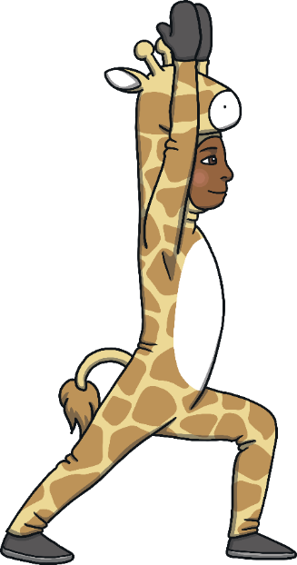
Giraffe
Let’s be a giraffe!
Start in standing.
Step one foot forwards.
Keep both feet steady on the floor.
Float your hands up overhead and get tall.
Now come on to your tiptoe hooves – try not to wobble!
Bring your feet flat on to the floor.
Repeat this pose twice or three times on each side.

Slide 26
Giraffe

Slide 27
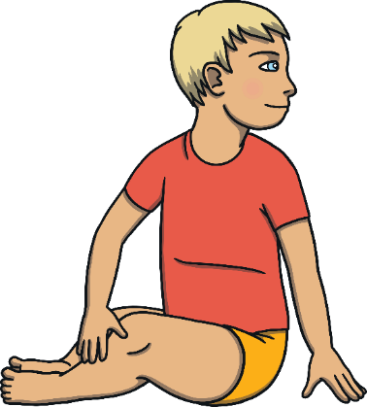
Orangutan
Things we need to know before we do the pose:
This pose helps your spine twist.
Your bottom needs to stay even on the floor.
You move your head gently and smoothly.
Your hands are relaxed on your legs.

Slide 28
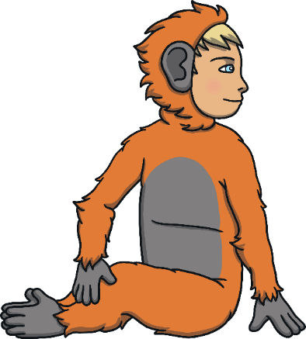
Orangutan
Let’s be an orangutan!
Sit with your feet out in front.
Bring your orangutan feet together so the soles of your feet touch.
Twist your tummy round and move your long orangutan arms.
Let your hand rest on your opposite knee.
Your free hand can, light as a feather, rest on the floor.
Breathe and enjoy the pose.
Smoothly come back out of the pose.
Repeat this pose twice or three times on each side.

Slide 29
Orangutan

Slide 30
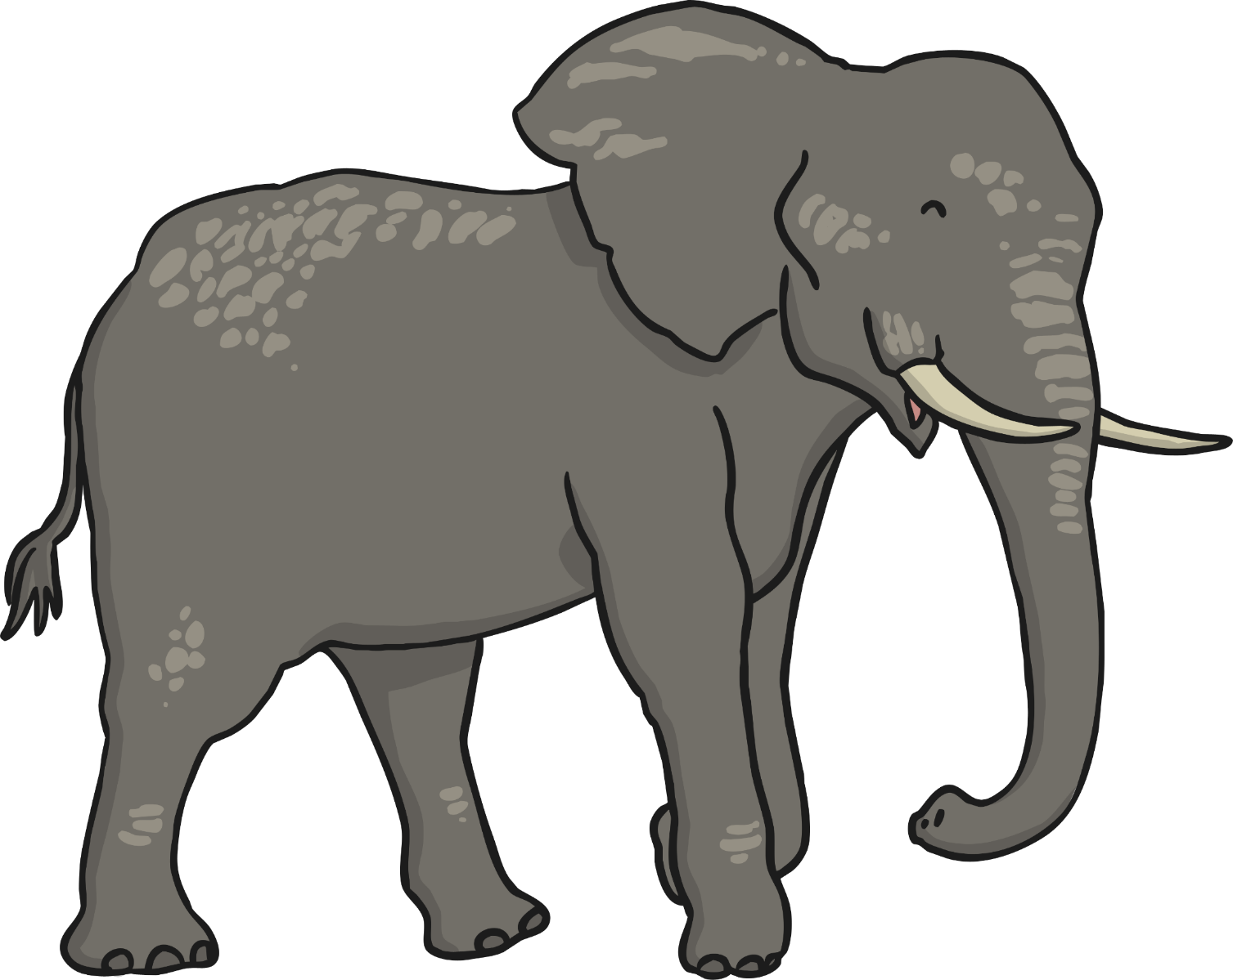
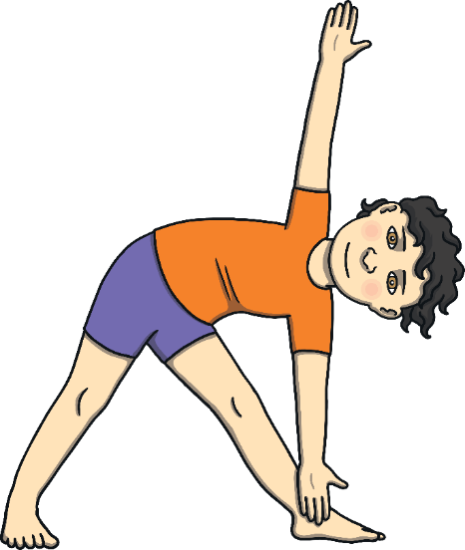
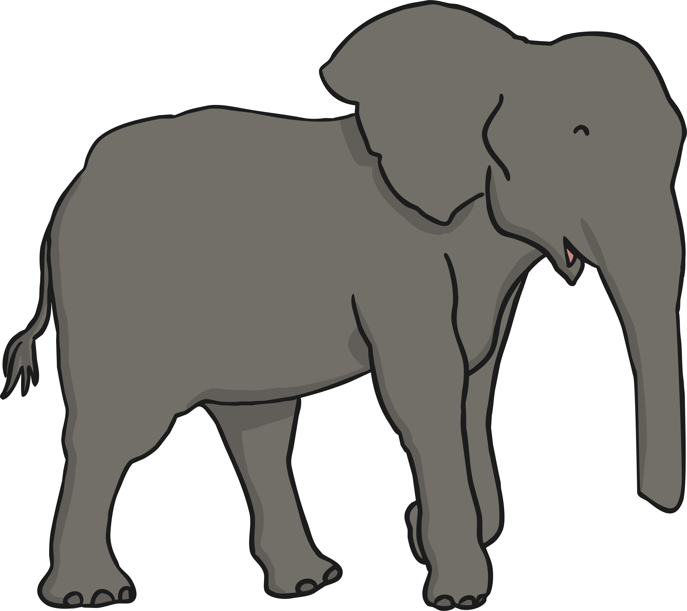
Elephant
Things we need to know before we do the pose:
This pose will stretch your chest.
Move in a way that is comfortable for you.
Move your arms less if it feels better.

Slide 31
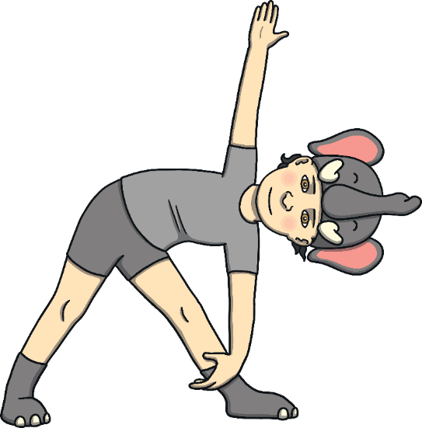
Elephant
Let’s be an elephant!
Start in standing with one foot forwards.
Let your hands, shoulders and back come down.
Imagine one hand is your long trunk and that you can suck up water.
Now sweep your trunk up to shower yourself with water as you come back up.
Then bring your trunk down.
Breathe and enjoy the pose.
Repeat this pose three to six times on each side.

Slide 32
Elephant

Slide 34
Creeper Breathing
We practise breathing to make our breath longer and so we can feel steadier.
Today, we’re going to breathe out and make an imaginary creeper with our breath.
We’re going to breathe out so long and steady that we feel like we can create a creeper.
As you breathe out, imagine a tiny thin creeper growing towards the centre of the room.
Breathe in and start again whenever you need to.
Now imagine the creeper gets thicker and stronger. Notice how your breath can spiral towards the centre of the room.
Send your breath out to a friend. Now another.
Notice how much your ribcage moves when you practise breathing.
How long can you make your breath out last?
Remember to take a new breath in whenever you need to.

Slide 36
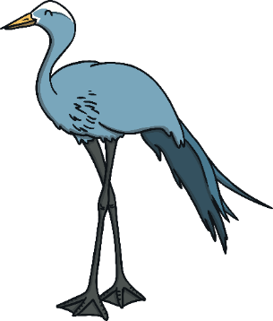
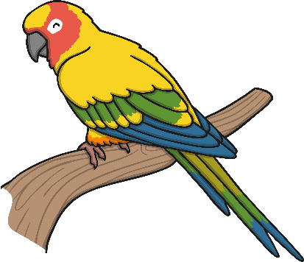
Song Bird Relaxation
Lie in a space of your own, touching no one.
Lie on your side or your back.
Look at the ceiling or close your eyes.
You have had a long and exciting journey. Now it’s time to rest.
You’re ready for a peaceful story.

Slide 37
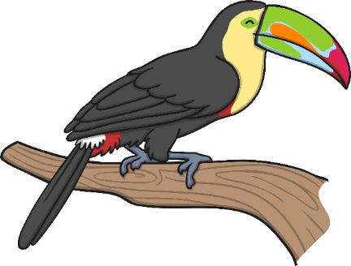
Song Bird Relaxation
You are in the loveliest jungle you have ever seen. You can hear the happy sound of birds tweeting. Sunlight comes through the trees. You feel peaceful and relaxed. You enjoy looking at the different sorts of green leaves. You come to a clearing in the jungle and there is a pool. The pool has giant lily pads on it. You step from one lily pad to another. They take your weight easily and move softly as you tread on them. The lily pads lead you to the largest flower you have ever seen. It is a giant lotus flower and it is as wide as a bed. It has soft, pinky-purple petals. You climb on to the giant flower. Each petal is as soft as silk. Snuggle down into the silky petals and take a nap. As you lie there, the flower very gently rocks you. You feel so happy.

Slide 38
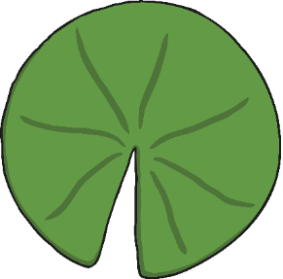
Song Bird Relaxation
You are in the loveliest jungle you have ever seen. You can hear the happy sound of birds tweeting. Sunlight comes through the trees. You feel peaceful and relaxed. You enjoy looking at the different sorts of green leaves. You come to a clearing in the jungle and there is a pool. The pool has giant lily pads on it. You step from one lily pad to another. They take your weight easily and move softly as you tread on them. The lily pads lead you to the largest flower you have ever seen. It is a giant lotus flower and it is as wide as a bed. It has soft, pinky-purple petals. You climb on to the giant flower. Each petal is as soft as silk. Snuggle down into the silky petals and take a nap. As you lie there, the flower very gently rocks you. You feel so happy.

Slide 39
Song Bird Relaxation
You are in the loveliest jungle you have ever seen. You can hear the happy sound of birds tweeting. Sunlight comes through the trees. You feel peaceful and relaxed. You enjoy looking at the different sorts of green leaves. You come to a clearing in the jungle and there is a pool. The pool has giant lily pads on it. You step from one lily pad to another. They take your weight easily and move softly as you tread on them. The lily pads lead you to the largest flower you have ever seen. It is a giant lotus flower and it is as wide as a bed. It has soft, pinky-purple petals. You climb on to the giant flower. Each petal is as soft as silk. Snuggle down into the silky petals and take a nap. As you lie there, the flower very gently rocks you. You feel so happy.

Slide 40
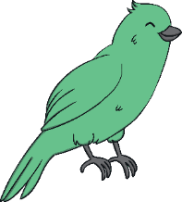
Song Bird Relaxation
A little bird comes down and sits beside you. Notice the bird; its bright colours, feathers and the way that it moves. It starts to sing a song. It sings a special song just for you. The song makes your heart swell and you feel happy from the tips of your toes to the tip of your nose. At the end of its song, the little bird takes a bow and flies off up into the trees again. You decide to walk back along the lily pads. Each lily pad makes a special noise when you stand on it. You find yourself back where you started, standing in the sunlight, in the happy jungle. You take a lovely breath in of the jungle air before it’s time to come home.

Slide 41
Song Bird Relaxation
A little bird comes down and sits beside you. Notice the bird; its bright colours, feathers and the way that it moves. It starts to sing a song. It sings a special song just for you. The song makes your heart swell and you feel happy from the tips of your toes to the tip of your nose. At the end of its song, the little bird takes a bow and flies off up into the trees again. You decide to walk back along the lily pads. Each lily pad makes a special noise when you stand on it. You find yourself back where you started, standing in the sunlight, in the happy jungle. You take a lovely breath in of the jungle air before it’s time to come home.

Slide 43
Lotus Meditation
Meditation is the trickiest part of yoga.
Shortly, we are going to learn how to sit quietly for a whole minute.
This will help you make your mind strong.

Slide 44
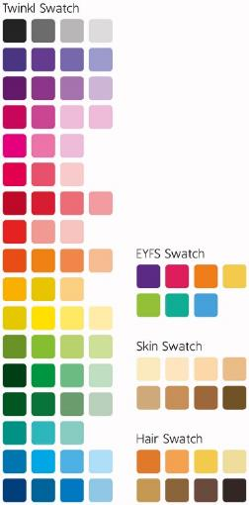
Lotus Meditation
Look at the centre of the lotus and stay focused.
Things to know before we do meditation:
Keep breathing evenly.
Keep your gaze on the lotus or close your eyes.
Stay focused and relaxed.
Start Timer

Slide 46
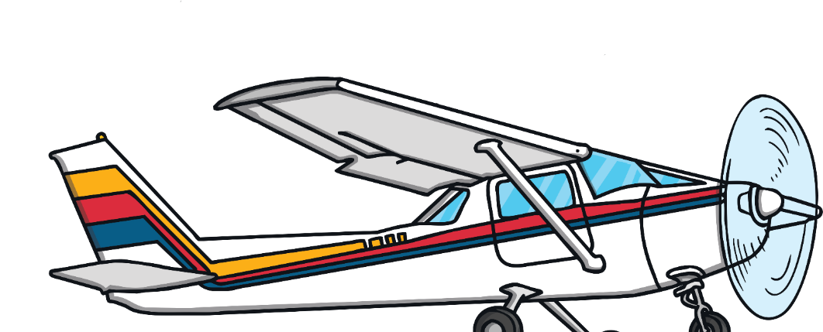
Flying Home
We have been on a yoga journey. We have learnt how to practise relaxed breathing and how to exercise our minds and bodies to help us feel calmer and happier.
It is time to fly home from our jungle expedition.
How did you feel during the lesson?
What have you learnt?

Slide 47
Aim
I can lengthen my spine and stand tall.
Success Criteria
I can keep my feet steady on the ground.
I can lift my head and soften my shoulders.
I can keep my body safe.

